Slide 1
Security
Network and Internet security
Cryptographic techniques
Cryptographic algorithms and protocols
Symmetric
Asymmetric
DI algorithms
Authentication pls
Cryptology
Cryptography - Art of devising ciphers
+
Cryptanalysis - Art of breaking ciphers
Notes:
Symmetric encryption, also referred to as conventional encryption or single-key encryption, was the only type of encryption in use prior to the development of public-key encryption in the 1970s. It remains by far the most widely used of the two types of encryption. All traditional schemes are symmetric / single key / private-key encryption algorithms, with a single key, used for both encryption and decryption. Since both sender and receiver are equivalent, either can encrypt or decrypt messages using that common key.

Slide 2
Symmetric Encryption
conventional / private-key / single-key
sender and recipient share a common key
all classical encryption algorithms are private-key
only type prior to invention of public-key in 1970’s
most widely used
m people in a group => m (m-1)/2 keys
Notes:
Symmetric encryption, also referred to as conventional encryption or single-key encryption, was the only type of encryption in use prior to the development of public-key encryption in the 1970s. It remains by far the most widely used of the two types of encryption. All traditional schemes are symmetric / single key / private-key encryption algorithms, with a single key, used for both encryption and decryption. Since both sender and receiver are equivalent, either can encrypt or decrypt messages using that common key.

Slide 3
Some Basic Terminology
plaintext - original message
ciphertext - coded message
cipher - algorithm for transforming plaintext to ciphertext
key - info used in cipher known only to sender/receiver
encipher (encrypt) - converting plaintext to ciphertext
decipher (decrypt) - recovering plaintext from ciphertext
cryptography - study of encryption principles/methods
cryptanalysis (codebreaking) - study of principles/ methods of deciphering ciphertext without knowing key
cryptology - field of both cryptography and cryptanalysis
Notes:
Briefly review some terminology used throughout the course.

Slide 4
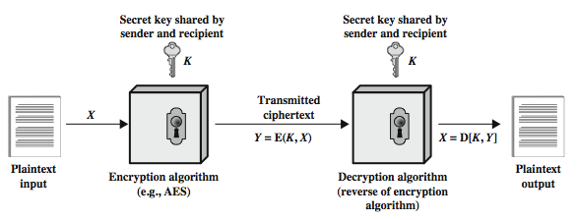
Symmetric Cipher Model
Notes:
Detail the five ingredients of the symmetric cipher model, shown in Stallings Figure 2.1:
plaintext - original message
encryption algorithm – performs substitutions/transformations on plaintext
secret key – control exact substitutions/transformations used in encryption algorithm
ciphertext - scrambled message
decryption algorithm – inverse of encryption algorithm

Slide 5
Requirements
two requirements for secure use of symmetric encryption:
a strong encryption algorithm
a secret key known only to sender / receiver
mathematically :
Y = E(K, X)
X = D(K, Y)
assume encryption algorithm is known
implies a secure channel to distribute key
Notes:
There are two requirements for secure use of conventional encryption that mean we assume that it is impractical to decrypt a message on the basis of the cipher- text plus knowledge of the encryption/decryption algorithm, and hence do not need to keep the algorithm secret; rather we only need to keep the key secret. This feature of symmetric encryption is what makes it feasible for widespread use. It allows easy distribution of s/w and h/w implementations.
Can take a closer look at the essential elements of a symmetric encryption scheme: mathematically it can be considered a pair of functions with: plaintext X, ciphertext Y, key K, encryption algorithm E, decryption algorithm D. The intended receiver, in possession of the key, is able to invert the transformation. An opponent, observing Y but not having access to K or X, may attempt to recover X or K.

Slide 6
Cryptography
can characterize cryptographic system by:
type of encryption operations used
substitution
transposition
product
number of keys used
single-key or private
two-key or public
way in which plaintext is processed
block
stream
Notes:
Cryptographic systems can be characterized along these three independent dimensions.
The type of operations used for transforming plaintext to ciphertext. All encryption algorithms are based on two general principles: substitution, in which each element in the plaintext (bit, letter, group of bits or letters) is mapped into another element, and transposition, in which elements in the plaintext are rearranged. The fundamental requirement is that no information be lost (that is, that all operations are reversible). Most systems, referred to as product systems, involve multiple stages of substitutions and transpositions.
The number of keys used. If both sender and receiver use the same key, the system is referred to as symmetric, single-key, secret-key, or conventional encryption. If the sender and receiver use different keys, the system is referred to as asymmetric, two-key, or public-key encryption.
The way in which the plaintext is processed. A block cipher processes the input one block of elements at a time, producing an output block for each input block. A stream cipher processes the input elements continuously, producing output one element at a time, as it goes along.

Slide 7
Kerckhoff’s Principle
Resistance of the cipher to attack – secrecy of the key
Guess – difficult
Key domain - large

Slide 8
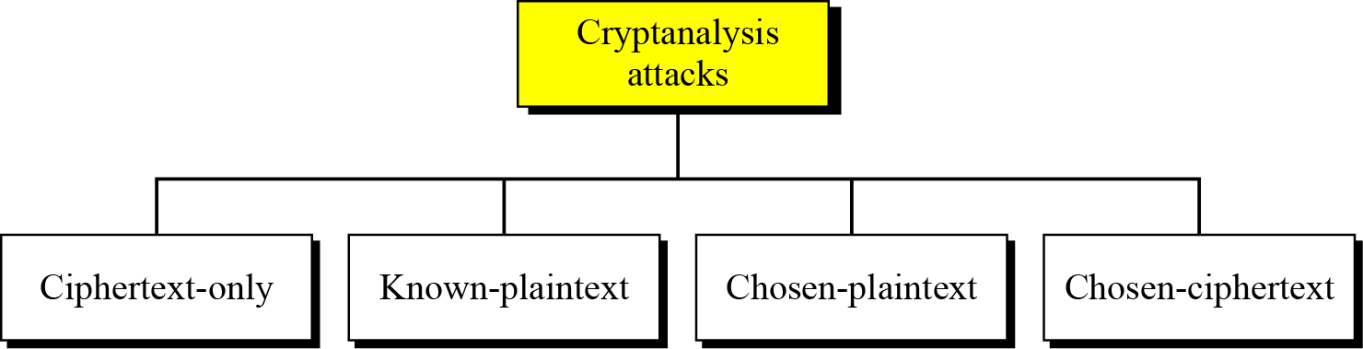
Cryptanalysis
As cryptography is the science and art of creating secret codes,
cryptanalysis is the science and art of breaking those codes.

Slide 9
Cryptanalytic Attacks
ciphertext only
only know algorithm & ciphertext, is statistical, know or can identify plaintext
known plaintext
know/suspect plaintext & ciphertext
chosen plaintext
select plaintext and obtain ciphertext
chosen ciphertext
select ciphertext and obtain plaintext
Notes:
Stallings Table 2.1 summarizes the various types of cryptanalytic attacks, based on the amount of information known to the cryptanalyst, from least to most. The most difficult problem is presented when all that is available is the ciphertext only. In some cases, not even the encryption algorithm is known, but in general we can assume that the opponent does know the algorithm used for encryption. Then with increasing information have the other attacks. Generally, an encryption algorithm is designed to withstand a known-plaintext attack.

Slide 10
More Definitions
unconditional security
no matter how much computer power or time is available, the cipher cannot be broken since the ciphertext provides insufficient information to uniquely determine the corresponding plaintext
computational security
given limited computing resources (eg time needed for calculations is greater than age of universe), the cipher cannot be broken
Notes:
Two more definitions are worthy of note. An encryption scheme is unconditionally secure if the ciphertext generated by the scheme does not contain enough information to determine uniquely the corresponding plaintext, no matter how much ciphertext is available. An encryption scheme is said to be computationally secure if either the cost of breaking the cipher exceeds the value of the encrypted information, or the time required to break the cipher exceeds the useful lifetime of the information. Unconditional security would be nice, but the only known such cipher is the one-time pad (later).
For all reasonable encryption algorithms, we have to assume computational security where it either takes too long, or is too expensive, to bother breaking the cipher.

Slide 11
Cryptanalysis
objective to recover key not just message
general approaches:
Brute-force attack
Cryptanalytic attack
Notes:
Typically objective is to recover the key in use rather then simply to recover the plaintext of a single ciphertext. There are two general approaches:
Cryptanalysis: relies on the nature of the algorithm plus perhaps some knowledge of the general characteristics of the plaintext or even some sample plaintext- ciphertext pairs. This type of attack exploits the characteristics of the algorithm to attempt to deduce a specific plaintext or to deduce the key being used.
Brute-force attacks try every possible key on a piece of ciphertext until an intelligible translation into plaintext is obtained. On average,half of all possible keys must be tried to achieve success.
If either type of attack succeeds in deducing the key, the effect is catastrophic: All future and past messages encrypted with that key are compromised.

Slide 12
Brute Force Attack
CT only attack
A communicates with B and E is the Intruder
Exhaustive key search attack
always possible to simply try every key
most basic attack, proportional to key size
assume – intruder knows the alg and key domain
Notes:
A brute-force attack involves trying every possible key until an intelligible translation of the ciphertext into plaintext is obtained. On average, half of all possible keys must be tried to achieve success. Stallings Table 2.2 shows how much time is required to conduct a brute-force attack, for various common key sizes (DES is 56, AES is 128, Triple-DES is 168, plus general mono-alphabetic cipher), where either a single system or a million parallel systems, are used.

Slide 13
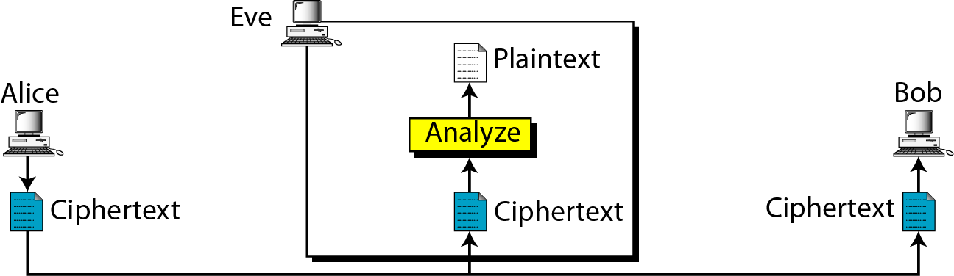
Statistical Attack
CT only attack
E uses the inherent characteristics of PT language
Eg. Letter e occurs frequently
Notes:
A brute-force attack involves trying every possible key until an intelligible translation of the ciphertext into plaintext is obtained. On average, half of all possible keys must be tried to achieve success. Stallings Table 2.2 shows how much time is required to conduct a brute-force attack, for various common key sizes (DES is 56, AES is 128, Triple-DES is 168, plus general mono-alphabetic cipher), where either a single system or a million parallel systems, are used.

Slide 14
Pattern Attack
CT only attack
E uses the inherent characteristics of PT language
Hide the chars of the language
THE
WKH
Randomize alg
Notes:
A brute-force attack involves trying every possible key until an intelligible translation of the ciphertext into plaintext is obtained. On average, half of all possible keys must be tried to achieve success. Stallings Table 2.2 shows how much time is required to conduct a brute-force attack, for various common key sizes (DES is 56, AES is 128, Triple-DES is 168, plus general mono-alphabetic cipher), where either a single system or a million parallel systems, are used.

Slide 15
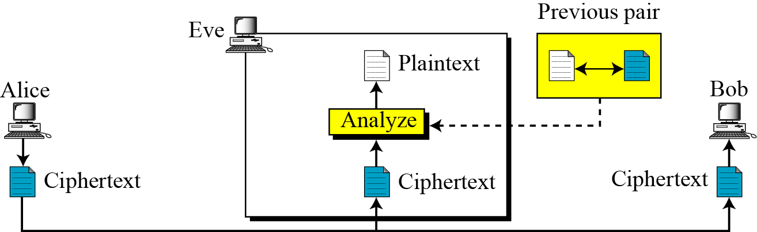
Known PT Attack
E uses the relationship b/w the previous pair to analyse the current CT
Eg. If ABBA then BABA
DEED EDED
Prevention – A need to use a different key
Notes:
A brute-force attack involves trying every possible key until an intelligible translation of the ciphertext into plaintext is obtained. On average, half of all possible keys must be tried to achieve success. Stallings Table 2.2 shows how much time is required to conduct a brute-force attack, for various common key sizes (DES is 56, AES is 128, Triple-DES is 168, plus general mono-alphabetic cipher), where either a single system or a million parallel systems, are used.

Slide 16
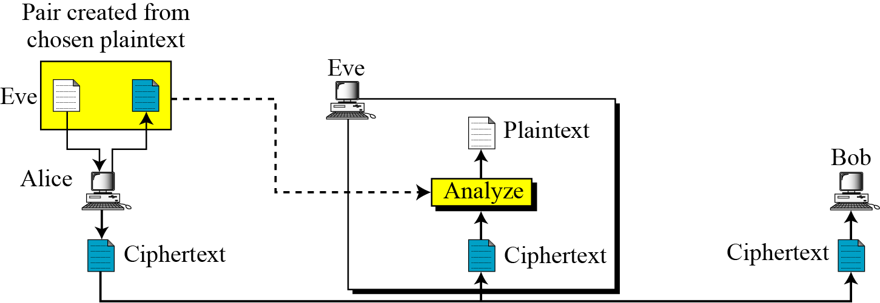
Chosen PT Attack
Similar to KPTA but PT/CT pairs chosen by E
E has access to A’s computer
Less likely to happen
Notes:
A brute-force attack involves trying every possible key until an intelligible translation of the ciphertext into plaintext is obtained. On average, half of all possible keys must be tried to achieve success. Stallings Table 2.2 shows how much time is required to conduct a brute-force attack, for various common key sizes (DES is 56, AES is 128, Triple-DES is 168, plus general mono-alphabetic cipher), where either a single system or a million parallel systems, are used.

Slide 17
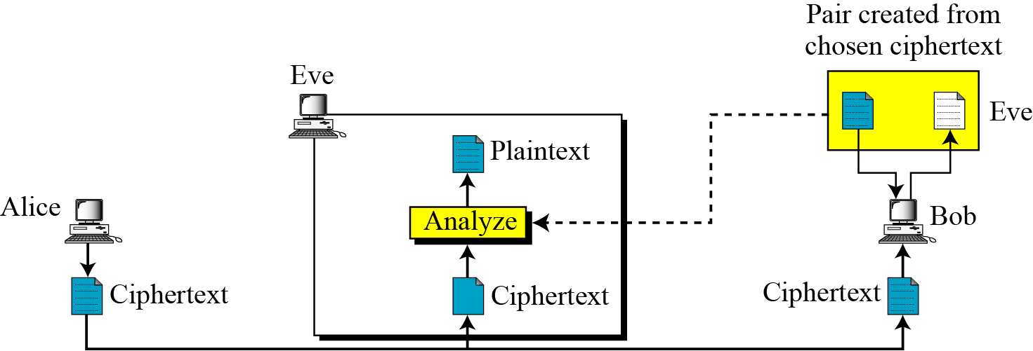
Chosen CT Attack
Similar to KPTA
But E chooses same CT and decrypts it from a CT/ PT pair
Can happen when E has access to B’s computer - Less likely
Notes:
A brute-force attack involves trying every possible key until an intelligible translation of the ciphertext into plaintext is obtained. On average, half of all possible keys must be tried to achieve success. Stallings Table 2.2 shows how much time is required to conduct a brute-force attack, for various common key sizes (DES is 56, AES is 128, Triple-DES is 168, plus general mono-alphabetic cipher), where either a single system or a million parallel systems, are used.

Slide 18
Categories of Traditional Ciphers
Substitution Cipher
Replace one symbol in PT with another
Monoalphabetic Cipher
Polyalphabetic Cipher
Transposition Cipher
Reorder the position of symbols in PT
Notes:
A brute-force attack involves trying every possible key until an intelligible translation of the ciphertext into plaintext is obtained. On average, half of all possible keys must be tried to achieve success. Stallings Table 2.2 shows how much time is required to conduct a brute-force attack, for various common key sizes (DES is 56, AES is 128, Triple-DES is 168, plus general mono-alphabetic cipher), where either a single system or a million parallel systems, are used.

Slide 19
Monoalphabetic Substitution Ciphers
In monoalphabetic substitution, the relationship between a symbol in the plaintext to a symbol in the ciphertext is always one-to-one.
letters of plaintext are replaced by other letters or by numbers or symbols
Notes:
In this section and the next, we examine a sampling of what might be called classical encryption techniques. A study of these techniques enables us to illustrate the basic approaches to symmetric encryption used today and the types of cryptanalytic attacks that must be anticipated. The two basic building blocks of all encryption technique are substitution and transposition. We examine these in the next two sections. Finally, we discuss a system that combine both substitution and transposition.
A substitution technique is one in which the letters of plaintext are replaced by other letters or by numbers or symbols. If the plaintext is viewed as a sequence of bits, then substitution involves replacing plaintext bit patterns with ciphertext bit patterns.

Slide 20
Additive /Shift / Caesar Cipher
earliest known substitution cipher
by Julius Caesar
first attested use in military affairs
replaces each letter by 3rd letter
example:
meet me after the party
PHHW PH DIWHU WKH SDUWB
ABBA ABBA
DEED QWWQ
Notes:
Substitution ciphers form the first of the fundamental building blocks. The core idea is to replace one basic unit (letter/byte) with another. Whilst the early Greeks described several substitution ciphers, the first attested use in military affairs of one was by Julius Caesar, described by him in Gallic Wars (cf. Kahn pp83-84). Still call any cipher using a simple letter shift a caesar cipher, not just those with shift 3.

Slide 21
Caesar Cipher
can define transformation as:
a b c d e f g h i j k l m n o p q r s t u v w x y z
D E F G H I J K L M N O P Q R S T U V W X Y Z A B C
mathematically give each letter a number
a b c d e f g h i j k l m n o p q r s t u v w x y z
0 1 2 3 4 5 6 7 8 9 10 11 12 13 14 15 16 17 18 19 20 21 22 23 24 25
then have Caesar cipher as:
c = E(k, p) = (p + k) mod (26)
p = D(k, c) = (c – k) mod (26)
Notes:
This mathematical description uses modulo (clock) arithmetic. Here, when you reach Z you go back to A and start again. Mod 26 implies that when you reach 26, you use 0 instead (ie the letter after Z, or 25 + 1 goes to A or 0).
Example: howdy (7,14,22,3,24) encrypted using key f (ie a shift of 5) is MTBID

Slide 22
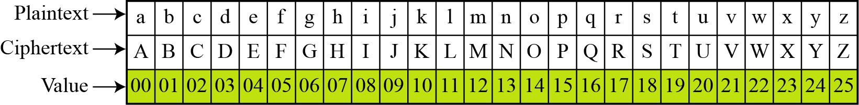
Caesar Cipher
PT and CT in Z₂₆
Notes:
This mathematical description uses modulo (clock) arithmetic. Here, when you reach Z you go back to A and start again. Mod 26 implies that when you reach 26, you use 0 instead (ie the letter after Z, or 25 + 1 goes to A or 0).
Example: howdy (7,14,22,3,24) encrypted using key f (ie a shift of 5) is MTBID

Slide 23
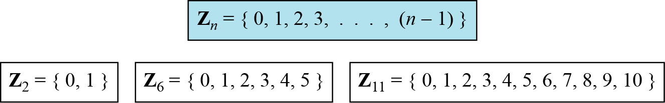
Caesar Cipher
The modulo operation creates a set, which in modular arithmetic is referred to as the set of least residues modulo n, or Z_{n}.
Eg some Z_{n} sets
Notes:
This mathematical description uses modulo (clock) arithmetic. Here, when you reach Z you go back to A and start again. Mod 26 implies that when you reach 26, you use 0 instead (ie the letter after Z, or 25 + 1 goes to A or 0).
Example: howdy (7,14,22,3,24) encrypted using key f (ie a shift of 5) is MTBID

Slide 24
Division operation has
two inputs (a and n)
and two outputs (q and r).
a = q × n + r
In modular arithmetic, only one of the outputs, the remainder r is of importance
MODULAR ARITHMETIC

Slide 25
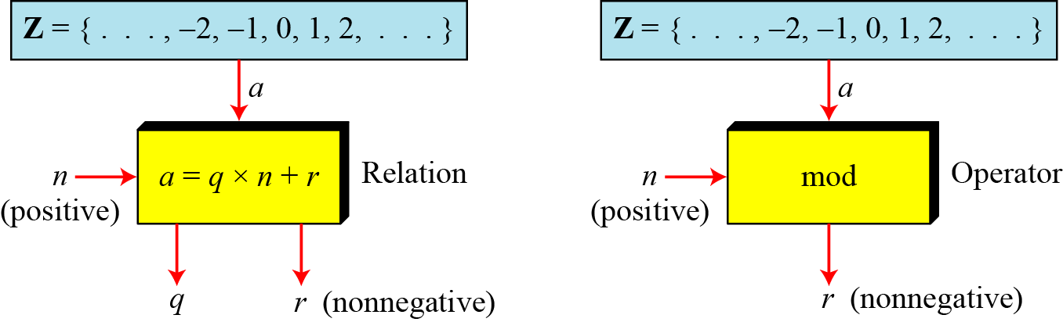
Modular Operator
The modulo operator is shown as mod. The second input (n) is called the modulus.
The output r is called the residue.
Notes:
Substitution ciphers form the first of the fundamental building blocks. The core idea is to replace one basic unit (letter/byte) with another. Whilst the early Greeks described several substitution ciphers, the first attested use in military affairs of one was by Julius Caesar, described by him in Gallic Wars (cf. Kahn pp83-84). Still call any cipher using a simple letter shift a caesar cipher, not just those with shift 3.

Slide 26
Modular Operator
Find the result of the following operations:
27 mod 5
b . 36 mod 12
−18 mod 14
d. −7 mod 10
Notes:
Substitution ciphers form the first of the fundamental building blocks. The core idea is to replace one basic unit (letter/byte) with another. Whilst the early Greeks described several substitution ciphers, the first attested use in military affairs of one was by Julius Caesar, described by him in Gallic Wars (cf. Kahn pp83-84). Still call any cipher using a simple letter shift a caesar cipher, not just those with shift 3.

Slide 27
Modular Operator
Find the result of the following operations:
27 mod 5
Dividing 27 by 5 results in r = 2
b .36 mod 12
Dividing 36 by 12 results in r = 0.
−18 mod 14
Dividing −18 by 14 results in r = −4. After adding the modulus r = 10
d. −7 mod 10
Dividing −7 by 10 results in r = −7. After adding the modulus to −7, r = 3.
Notes:
Substitution ciphers form the first of the fundamental building blocks. The core idea is to replace one basic unit (letter/byte) with another. Whilst the early Greeks described several substitution ciphers, the first attested use in military affairs of one was by Julius Caesar, described by him in Gallic Wars (cf. Kahn pp83-84). Still call any cipher using a simple letter shift a caesar cipher, not just those with shift 3.

Slide 28
Set of Residues
The modulo operation creates a set, which in modular arithmetic is referred to as the set of least residues modulo n, or Z_{n}.
Eg. Some Z_{n} sets
Notes:
Substitution ciphers form the first of the fundamental building blocks. The core idea is to replace one basic unit (letter/byte) with another. Whilst the early Greeks described several substitution ciphers, the first attested use in military affairs of one was by Julius Caesar, described by him in Gallic Wars (cf. Kahn pp83-84). Still call any cipher using a simple letter shift a caesar cipher, not just those with shift 3.

Slide 29
Congruence
In Cryptography,
concept of congruence is used instead of equality.
To show that two integers are congruent, we use the congruence operator ( ≡ ).
Congruence optr maps a member from Z to a member of Z_{n.}

Slide 30
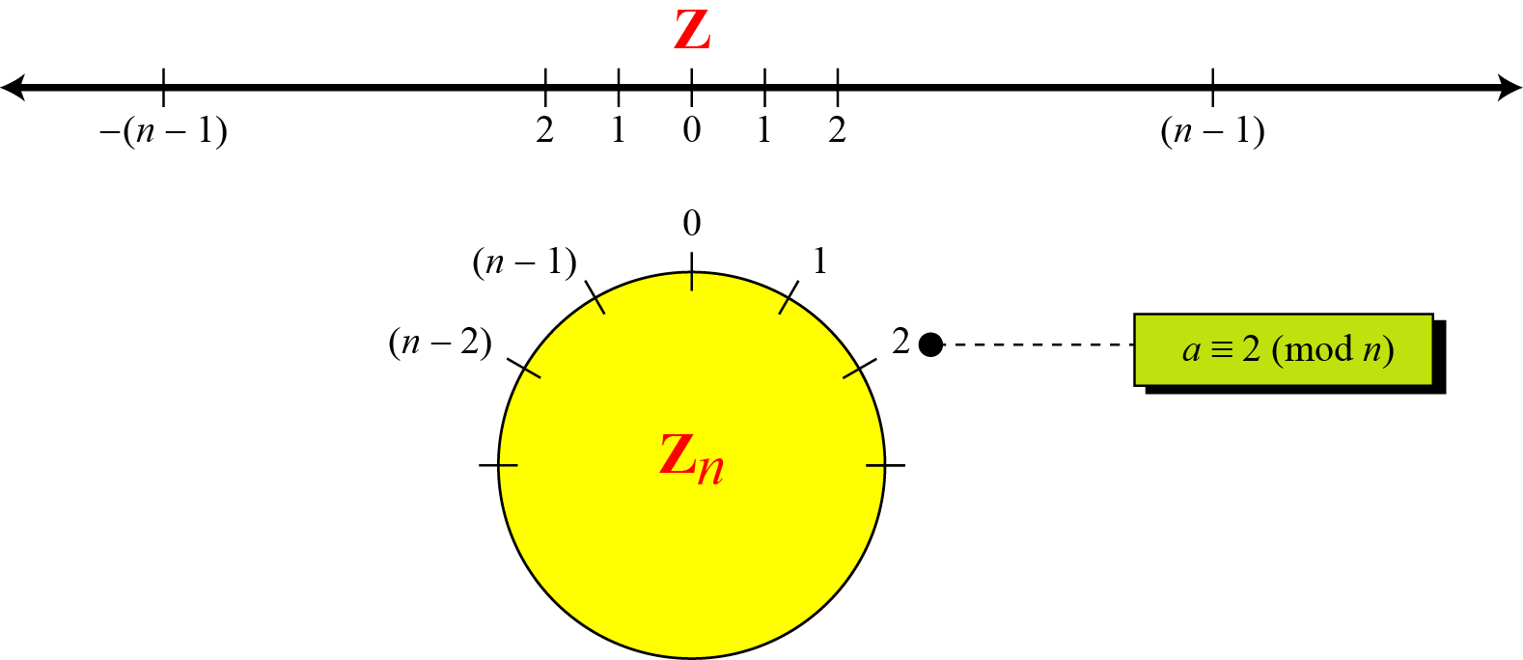
Comparison of Z and Z_{n} using graphs
Notes:
Substitution ciphers form the first of the fundamental building blocks. The core idea is to replace one basic unit (letter/byte) with another. Whilst the early Greeks described several substitution ciphers, the first attested use in military affairs of one was by Julius Caesar, described by him in Gallic Wars (cf. Kahn pp83-84). Still call any cipher using a simple letter shift a caesar cipher, not just those with shift 3.

Slide 31
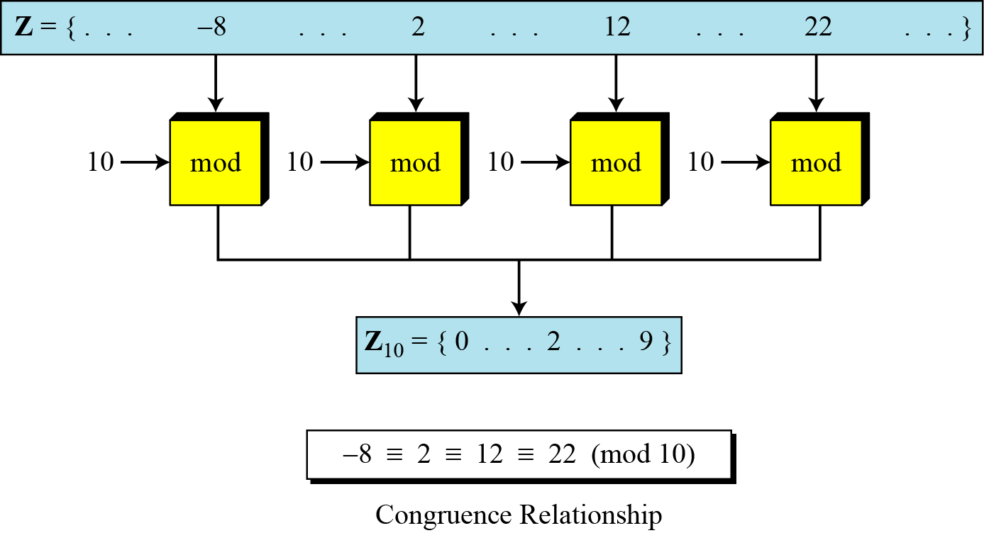
Concept of congruence - Continued

Slide 32
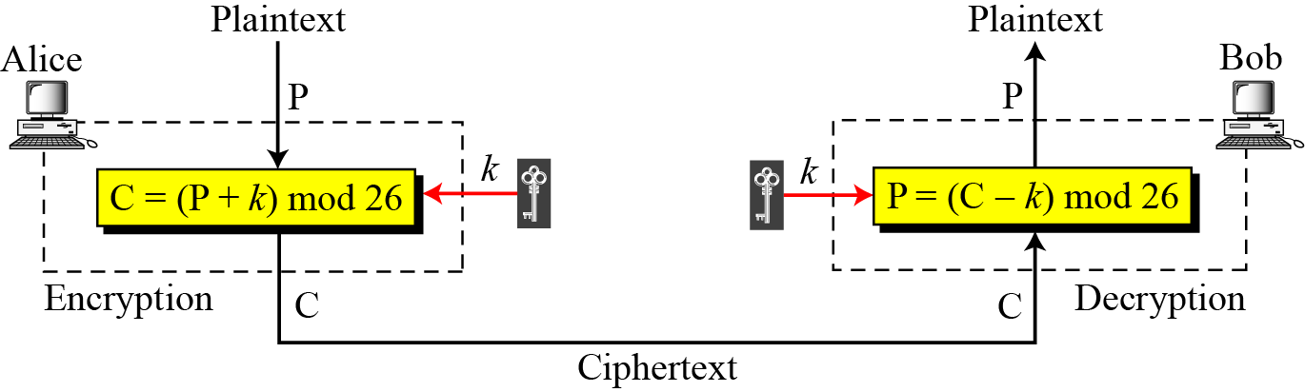
Additive cipher
When the cipher is additive, the plaintext, ciphertext, and key are integers in Z₂₆.

Slide 33
Additive cipher
Use the additive cipher with key = 15 to encrypt the message “hello”.
Solution
We apply the encryption algorithm to the plaintext, character by character:

Slide 34
Additive cipher
Use the additive cipher with key = 15 to encrypt the message “hello”.
Solution
We apply the encryption algorithm to the plaintext, character by character:

Slide 35
Additive cipher
Use the additive cipher with key = 15 to decrypt the message “WTAAD”.
Solution
We apply the decryption algorithm to the plaintext character by character:
a+ b ≡ 0 (mod n)
Additive inverse of a is calculated as b=n-a

Slide 36
Additive cipher
Eve has intercepted the following ciphertext. Using a statistical attack, find the plaintext.

Slide 37
Additive cipher
Eve has intercepted the following ciphertext. Using a statistical attack, find the plaintext.
Solution
When Eve tabulates the frequency of letters in this ciphertext, she gets: I =14, V =13, S =12, and so on. The most common character is I with 14 occurrences.
What is the key?

Slide 38
Additive cipher
Eve has intercepted the following ciphertext. Using a statistical attack, find the plaintext.
Solution
When Eve tabulates the frequency of letters in this ciphertext, she gets: I =14, V =13, S =12, and so on. The most common character is I with 14 occurrences. This means key = 4.

Slide 39
Additive cipher
Eve has intercepted the following ciphertext. Using a statistical attack, find the plaintext.
Solution
When Eve tabulates the frequency of letters in this ciphertext, she gets: I =14, V =13, S =12, and so on. The most common character is I with 14 occurrences. This means key = 4.

Slide 40
Additive cipher
Cryptanalysis
Attacks possible
Brute Force attack
Statistical attack
:

Slide 41
Additive cipher
Cryptanalysis
Attacks possible
Brute Force attack
Exhaustive key search – key domain is small
Statistical attack
Digrams - IN,AN,OR,AT
Trigrams - THE, AND, FOR
:

Slide 42
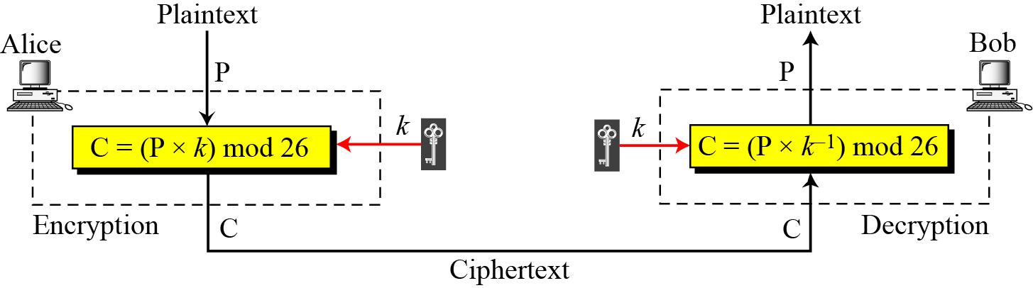
Multiplicative Ciphers
In a multiplicative cipher, the plaintext and ciphertext are integers in Z₂₆; the key is an integer in Z26*.

Slide 43
Multiplicative Cipher – Contd…
a * b ≡ 1 (mod n)
Z_{n} cannot be the set of possible keys because
Only some members of the set have multiplicative inverse
A subset of Z₂₆ with integers in Z₂₆ that have an unique set Z*₂₆

Slide 44
Multiplicative Ciphers
Z₆
Z₆*
Z₇
Z₇*.
The key needs to be in Z₂₆*.
This set has only 12 members: 1, 3, 5, 7, 9, 11, 15, 17, 19, 21, 23, 25.
Compute Z_{n}* for n = 6,7,10,26
Solution

Slide 45
Multiplicative Ciphers
What is the key domain for any multiplicative cipher?
Solution
The key needs to be in Z₂₆*.
This set has only 12 members: 1, 3, 5, 7, 9, 11, 15, 17, 19, 21, 23, 25.

Slide 46
Multiplicative Ciphers
What is the key domain for any multiplicative cipher?
Solution
The key needs to be in Z₂₆*. This set has only 12 members: 1, 3, 5, 7, 9, 11, 15, 17, 19, 21, 23, 25.
We use a multiplicative cipher to encrypt the message “hello” with a key of 7. The ciphertext is “XCZZU”.

Slide 47
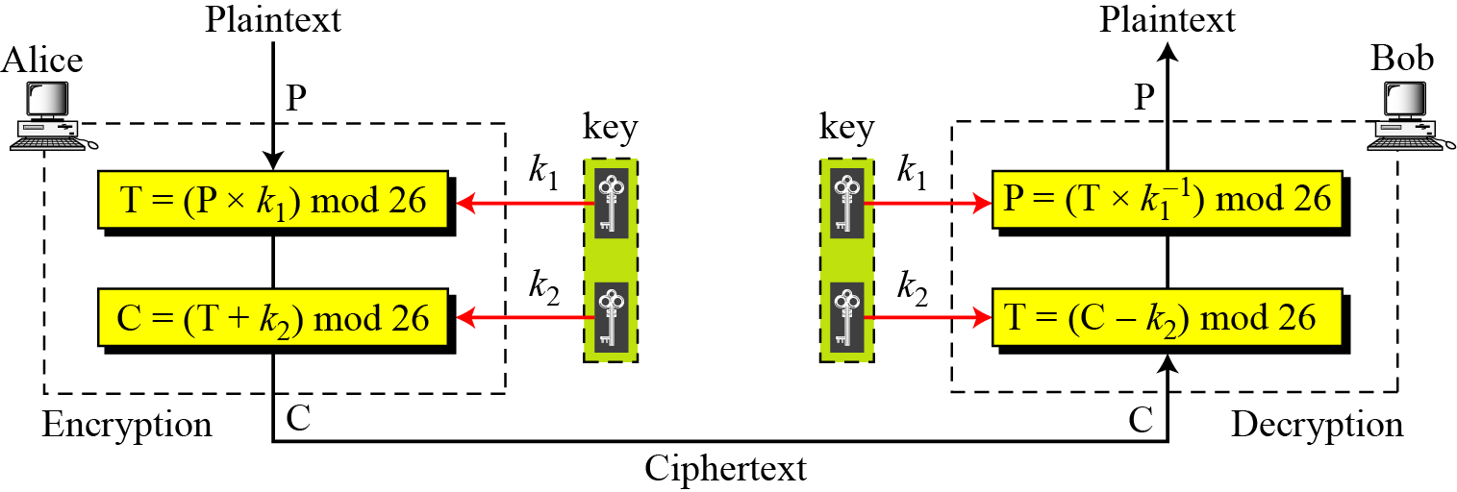
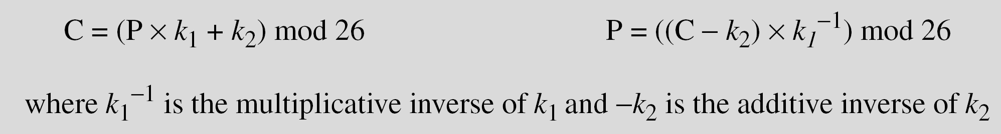
Affine Ciphers
Combination of Additive and Multiplicative Cipher
1st key is Multiplicative Cipher
2nd key is Additive Cipher

Slide 48
Affine Ciphers
The affine cipher uses a pair of keys in which the first key is from Z₂₆* and the second is from Z₂₆. The size of the key domain is 26 × 12 = 312.
Use an affine cipher to encrypt the message “hello” with the key pair (7, 2).

Slide 49
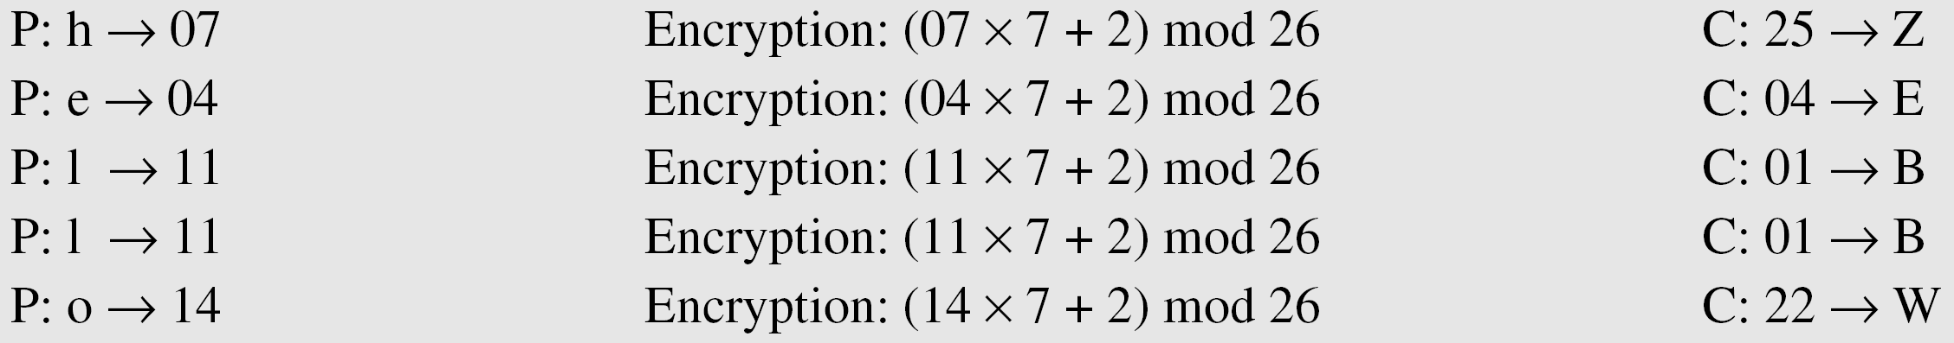
Affine Ciphers
The affine cipher uses a pair of keys in which the first key is from Z₂₆* and the second is from Z₂₆. The size of the key domain is 26 × 12 = 312.
Use an affine cipher to encrypt the message “hello” with the key pair (7, 2).

Slide 50
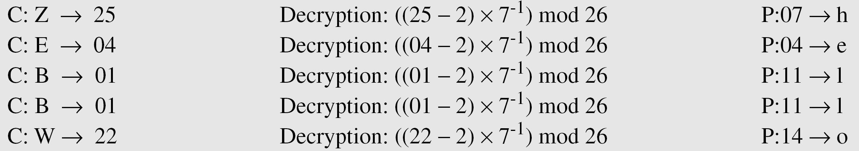
Affine Ciphers
Use the affine cipher to decrypt the message “ZEBBW” with the key pair (7, 2) in modulus 26.
Solution

Slide 51
Affine Ciphers
Brute force attack
CT only attack
Chosen PT attack

Slide 52
The additive cipher is a special case of an affine cipher in which k₁ = 1.
The multiplicative cipher is a special case of affine cipher in which k₂ = 0.

Slide 53
Cryptanalysis of Affine Cipher
Brute Force Attack
Ciphertext only Attack
Chosen Plaintext Attack
Alg 1 PT et CT wc
e - w 04 – 22 04 * k1 + k2 = 22 (mod 26)
t -c 19 – 02 19 * k1 + k2 = 02(mod 26)
Alg 2 PT et CT wf
Affine Ciphers

Slide 54
each occurrence of a character may have a different
substitute.
The relationship between a character in the plaintext to a character in the ciphertext is one-to-many.
Hides the letter frequency of the underlying language
To create a PC, make each CT char dependent on
corresponding PT char
posn of PT char in msg
Key should be a stream of subkeys
K = ( K₁, K₂, K₃,…)
In which K_{i} is used to cipher the i^{th} char in PT to create the i^{th} char in CT
Polyalphabetic Ciphers

Slide 55
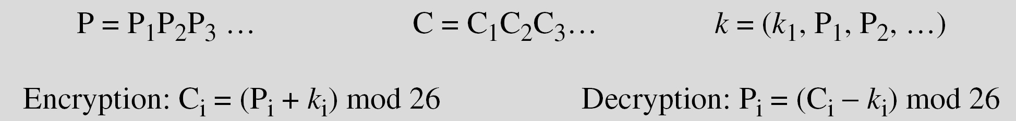
Polyalphabetic Ciphers
1st subkey is predetermined value agreed by A and B
2nd subkey is the value of 1st PT char (b/w 0 and 25)
3rd subkey is the value of 2nd PT char and so on…
Autokey Cipher

Slide 56
Polyalphabetic Ciphers
Assume that Alice and Bob agreed to use an autokey cipher with initial key value k₁ = 12.
Alice wants to send Bob the message
“Attack is today”.
Enciphering is done character by character.

Slide 57
Polyalphabetic Ciphers
Assume that Alice and Bob agreed to use an autokey cipher with initial key value k₁ = 12. Now Alice wants to send Bob the message “Attack is today”. Enciphering is done character by character.

Slide 58
Playfair Cipher
Secret key is made of 24 alphabets – 5 by 5 matrix
letters I and J considered same
Diff arrangements – diff secret keys
Rules for encryption:
2 letters in a pair are same, bogus letter inserted to separate them
No of chars is odd, one bogus letter inserted to make it even
if 2 letters in a pair are located in the same row of secret key, then the letter to their right is the encrypted key
if 2 letters in a pair are located in the same col of secret key, then the letter beneath it in the same col is the encrypted key
if 2 letters in a pair are not located in the same row or col of secret key, then the letter that is in its own row but in the same col as the other letter is the encrypted key

Slide 59
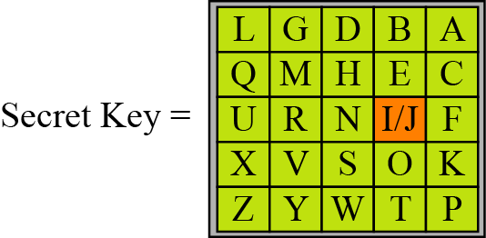
Playfair Cipher
An example of a secret key in the Playfair cipher
Let us encrypt the plaintext “hello” using the key

Slide 60
Playfair Cipher
An example of a secret key in the Playfair cipher
Plain Text = hello Cipher Text = ?????
Let us encrypt the plaintext “hello” using the key

Slide 61
Playfair Cipher
Let us encrypt the plaintext “hello” using the key
PT is hello
l is repeated and so PT becomes helxlo
No of chars are even
he - same row , hence letter to their right is encrypted key
so, for he , it is EC

Slide 62
Playfair Cipher
Let us encrypt the plaintext “hello” using the key
PT is hello
l is repeated and so PT becomes helxlo
No of chars are even
he - same row , hence letter to their right is encrypted key
so, for he , it is EC
lx - same col, hence the letter beneath it in the same col is the encrypted key, so, for lx , it is QZ
lo - not is same row or col, letter that is in its own row but in the same col as the other letter is the encrypted key, so, for lo, it is BX
helxlo

Slide 63
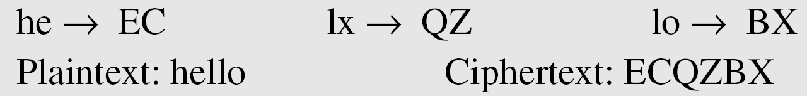
Playfair Cipher
Let us encrypt the plaintext “hello” using the key
PT is hello
l is repeated and so PT becomes helxlo
No of chars are even
he - same row , hence letter to their right is encrypted key
so, for he , it is EC
lx - same col, hence the letter beneath it in the same col is the encrypted key, so, for lx , it is QZ
lo - not is same row or col, letter that is in its own row but in the same col as the other letter is the encrypted key, so, for lo, it is BX

Slide 64
Vigenere Cipher
Example 3.16
We can encrypt the message “She is listening” using the 6-character keyword “PASCAL”.

Slide 65
Vigenere Cipher
Let us see how we can encrypt the message “She is listening” using the 6-character keyword “PASCAL”. The initial key stream is (15, 0, 18, 2, 0, 11). The key stream is the repetition of this initial key stream (as many times as needed).

Slide 66
Vigenere Cipher
Let us see how we can encrypt the message “She is listening” using the 6-character keyword “PASCAL”. The initial key stream is (15, 0, 18, 2, 0, 11). The key stream is the repetition of this initial key stream (as many times as needed).

Slide 67
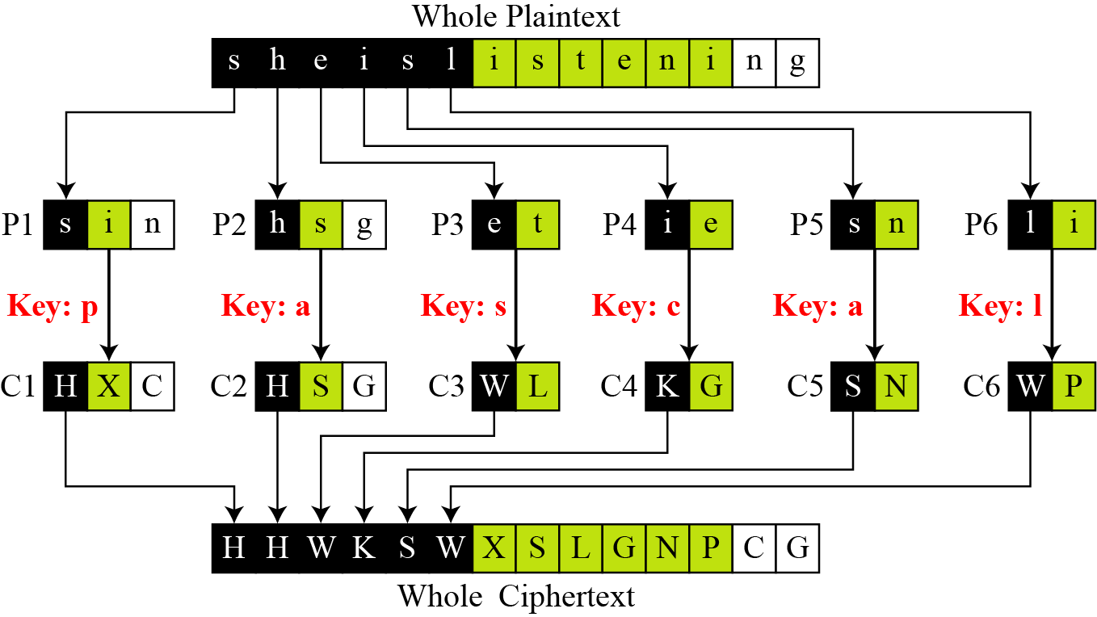
Vigenere Cipher
Vigenere cipher can be seen as combinations of m additive ciphers.
A Vigenere cipher is a combination of m additive ciphers

Slide 68
the additive cipher is a special case of Vigenere cipher in which m = 1.

Slide 69
One-Time Pad
One of the goals of cryptography is perfect secrecy.
A study by Shannon has shown that perfect secrecy can be achieved
if each plaintext symbol is encrypted with a key randomly chosen from a key domain.
This idea is used in a cipher called One-Time Pad, invented by Vernam.

Slide 70
TRANSPOSITION CIPHERS
A transposition cipher
No substitution
Changes/ reorders / transposes the location of the symbols.

Slide 71
Keyless Transposition Ciphers
PT --- >Meet me at the park
A Keyless cipher is the rail fence cipher.
PT written into a table col by col - 2 ROWS
CT created by reading row by row
PT written into a table row by row – 2 COLS
CT created by reading col by col

Slide 72
Keyless Transposition Ciphers
PT --- >Meet me at the park
A Keyless cipher is the rail fence cipher.
PT written into a table col by col - 2 rows
CT created by reading row by row
PT written into a table row by row – 2 cols
CT created by reading col by col
This creates the CT as “MEMATEAKETETHPR”.

Slide 73
Keyless Transposition Ciphers
PT --- >Meet me at the park
A Keyless cipher is the rail fence cipher.
PT written into a table col by col - 2 rows
CT created by reading row by row
PT written into a table row by row – 2 cols
CT created by reading col by col

Slide 74
Keyless Transposition Ciphers
Alice and Bob can agree on the number of columns and use the second method. Alice writes the same plaintext, row by row, in a table of four columns.
e

Slide 75
Keyless Transposition Ciphers
Alice and Bob can agree on the number of columns and use the second method. Alice writes the same plaintext, row by row, in a table of four columns.
e
This creates the CT “MMTAEEHREAEKTTP”.

Slide 76
Encryption key is ( 3,2,6,1,5,4)
What is the Decryption key?
Transposition Ciphers

Slide 77
Encryption key is ( 3,2,6,1,5,4)
What is the Decryption key?
(4,2,1,6,5,3)
Represent ( 3,2,6,1,5,4) and its decryption key in matrix form
Transposition Ciphers

Slide 78
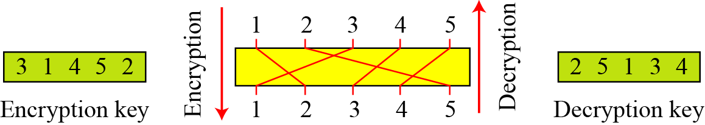
Encryption key is ( 3,2,6,1,5,4)
What is the Decryption key?
(4,2,1,6,5,3)
Represent ( 3,2,6,1,5,4) and its decryption key in matrix form
Transposition Ciphers

Slide 79
Cryptanalysis of Transposition Ciphers
Statistical attack
Brute Force attack 26^m ;
m =5: L = 20
No of columns = 1/ 20/ 2/4/5/10
Pattern attack

Slide 80
STREAM AND BLOCK CIPHERS
Symmetric ciphers ---- two broad categories
stream ciphers
block ciphers.

Slide 81
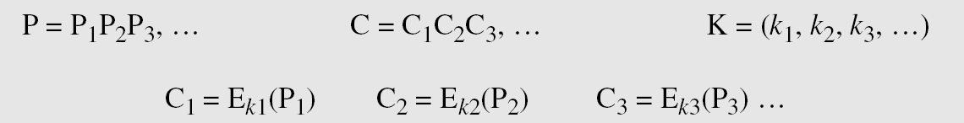
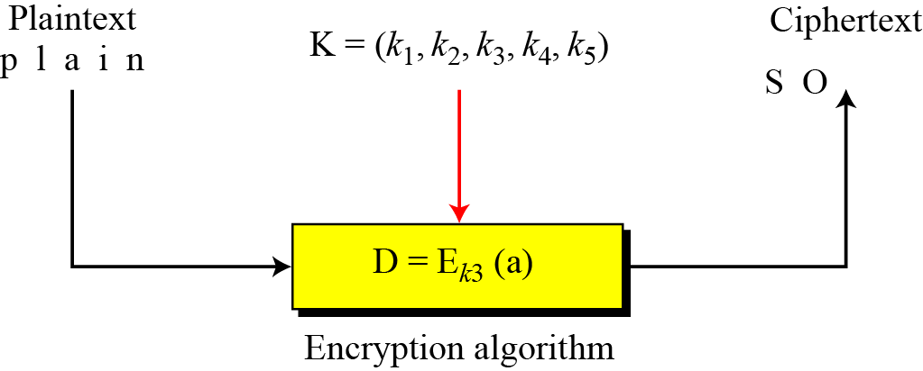
Stream Ciphers
Let the plaintext stream be P,
the ciphertext stream be C,
and the key stream K.

Slide 82
Stream Ciphers
Additive ciphers
stream ciphers --- key stream is the repeated value of the key. K = (k, k, …, k).
In this cipher,
each CT char depends only on the corresponding PT char
as the key stream is generated independently.
The monoalphabetic substitution ciphers
stream ciphers.
each value of the key stream is the mapping of the current PT char to the corresponding CT char in the mapping table.

Slide 83
Stream Ciphers
Vigenere ciphers
stream ciphers.
the key stream is a repetition of m values, where m is the size of the keyword.
A stream cipher is a monoalphabetic cipher
if the value of k_{i} does not depend on the posn of the PT char
otherwise, the cipher is polyalphabetic.

Slide 84
Stream Ciphers
Additive ciphers are definitely monoalphabetic
because k_{i} in the key stream is fixed; it does not depend on the position of the character in the plaintext.
Monoalphabetic substitution ciphers are monoalphabetic because k_{i} does not depend on the position of the corresponding character in the plaintext stream; it depends only on the value of the plaintext character.
Vigenere ciphers are polyalphabetic ciphers
because k_{i} definitely depends on the position of the plaintext character. However, the dependency is cyclic. The key is the same for two characters m positions apart.

Slide 85
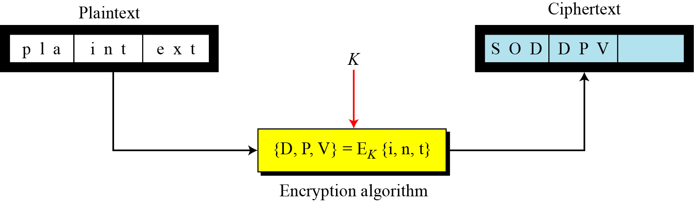
Block Ciphers
In a block cipher,
a group of PT symbols of size m (m > 1) are encrypted together creating a group of CT of the same size.
A single key is used to encrypt the whole block even if the key is made of multiple values.

Slide 86
Block Ciphers
Playfair ciphers
block ciphers.
size of the block is m = 2.
Two characters are encrypted together.
Hill ciphers
block ciphers.
A block of plaintext, of size 2 or more is encrypted together using a single key (a matrix).
In these ciphers, the value of each character in the CT depends on all the values of the characters in the PT.
Although the key is made of m × m values, it is considered as a single key.

Slide 87
Block Ciphers
Every block cipher
is a polyalphabetic cipher
as each character in a CT block depends on all characters in the PT block.

Slide 88
In practice,
blocks of plaintext are encrypted individually
but they use a stream of keys to encrypt the whole message, block by block.
In other words, the cipher
is a block cipher when looking at the individual blocks,
but it is a stream cipher when looking at the whole message considering each block as a single unit.
Combination

Slide 89
Monoalphabetic Cipher Security
now have a total of 26! = 4 x 10²⁶ keys
with so many keys, might think is secure
but would be !!!WRONG!!!
problem is language characteristics
Notes:
Note that even given the very large number of keys, being 10 orders of magnitude greater than the key space for DES, the monoalphabetic substitution cipher is not secure, because it does not sufficiently obscure the underlying language characteristics.

Slide 90
Language Redundancy and Cryptanalysis
human languages are redundant
eg "th lrd s m shphrd shll nt wnt"
letters are not equally commonly used
in English E is by far the most common letter
followed by T,R,N,I,O,A,S
other letters like Z,J,K,Q,X are fairly rare
have tables of single, double & triple letter frequencies for various languages
Notes:
As the example shows, we don't actually need all the letters in order to understand written English text. Here vowels were removed, but they're not the only redundancy. cf written Hebrew has no vowels for same reason. Are usually familiar with "party conversations", can hear one person speaking out of hubbub of many, again because of redundancy in aural language also. This redundancy is also the reason we can compress text files, the computer can derive a more compact encoding without losing any information. Basic idea is to count the relative frequencies of letters, and note the resulting pattern.

Slide 91
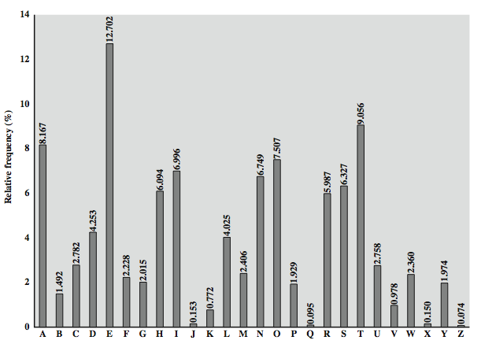
English Letter Frequencies
Notes:
Note that all human languages have varying letter frequencies, though the number of letters and their frequencies varies. Stallings Figure 2.5 shows English letter frequencies. Seberry & Pieprzyk, "Cryptography - An Introduction to Computer Security", Prentice-Hall 1989, Appendix A has letter frequency graphs for 20 languages (most European & Japanese & Malay). Also useful are tables of common two-letter combinations, known as digrams, and three-letter combinations, known as trigrams.

Slide 92
Use in Cryptanalysis
key concept - monoalphabetic substitution ciphers do not change relative letter frequencies
discovered by Arabian scientists in 9th century
calculate letter frequencies for ciphertext
compare counts/plots against known values
if caesar cipher look for common peaks/troughs
peaks at: A-E-I triple, NO pair, RST triple
troughs at: JK, X-Z
for monoalphabetic must identify each letter
tables of common double/triple letters help
Notes:
The simplicity and strength of the monoalphabetic substitution cipher meant it dominated cryptographic use for the first millenium AD. It was broken by Arabic scientists. The earliest known description is in Abu al-Kindi's "A Manuscript on Deciphering Cryptographic Messages", published in the 9th century but only rediscovered in 1987 in Istanbul, but other later works also attest to their knowledge of the field. Monoalphabetic ciphers are easy to break because they reflect the frequency data of the original alphabet. The cryptanalyst looks for a mapping between the observed pattern in the ciphertext, and the known source language letter frequencies. If English, look for peaks at: A-E-I triple, NO pair, RST triple, and troughs at: JK, X-Z.
Monoalphabetic ciphers are easy to break because they reflect the frequency data of the original alphabet.

Slide 93
Example Cryptanalysis
given ciphertext:
UZQSOVUOHXMOPVGPOZPEVSGZWSZOPFPESXUDBMETSXAIZ
VUEPHZHMDZSHZOWSFPAPPDTSVPQUZWYMXUZUHSX
EPYEPOPDZSZUFPOMBZWPFUPZHMDJUDTMOHMQ
count relative letter frequencies (see text)
guess P & Z are e and t
guess ZW is th and hence ZWP is the
proceeding with trial and error finally get:
it was disclosed yesterday that several informal but
direct contacts have been made with political
representatives of the viet cong in moscow
Notes:
Illustrate the process with this example from the text in Stallings section 2.2. Comparing letter frequency breakdown with Figure 2.5, it seems likely that cipher letters P and Z are the equivalents of plain letters e and t, but it is not certain which is which. The letters S, U, O, M, and H are all of relatively high frequency and probably correspond to plain letters from the set {a, h, i, n, o, r, s}. The letters with the lowest frequencies (namely, A, B, G, Y, I, J) are likely included in the set {b, j, k, q, v, x, z}. A powerful tool is to look at the frequency of two-letter combinations, known as digrams. A table similar to Figure 2.5 could be drawn up showing the relative frequency of digrams. The most common such digram is th. In our ciphertext, the most common digram is ZW, which appears three times. So we make the correspondence of Z with t and W with h. Then, by our earlier hypothesis, we can equate P with e. Now notice that the sequence ZWP appears in the ciphertext, and we can translate that sequence as "the." This is the most frequent trigram (three- letter combination) in English, which seems to indicate that we are on the right track. Next, notice the sequence ZWSZ in the first line. We do not know that these four letters form a complete word, but if they do, it is of the form th_t. If so, S equates with a. Only four letters have been identified, but already we have quite a bit of the message. Continued analysis of frequencies plus trial and error should easily yield a solution from this point. The complete plaintext, with spaces added between words, is shown on slide.

Slide 94
Playfair Cipher
not even the large number of keys in a monoalphabetic cipher provides security
one approach to improving security was to encrypt multiple letters
the Playfair Cipher is an example
invented by Charles Wheatstone in 1854, but named after his friend Baron Playfair
Notes:
Consider ways to reduce the "spikyness" of natural language text, since if just map one letter always to another, the frequency distribution is just shuffled. One approach is to encrypt more than one letter at once. The Playfair cipher is an example of doing this, treats digrams in the plaintext as single units and translates these units into ciphertext digrams.

Slide 95
Playfair Key Matrix
a 5X5 matrix of letters based on a keyword
fill in letters of keyword (sans duplicates)
fill rest of matrix with other letters
eg. using the keyword MONARCHY
M | O | N | A | R
C | H | Y | B | D
E | F | G | I/J | K
L | P | Q | S | T
U | V | W | X | Z
Notes:
The best-known multiple-letter encryption cipher is the Playfair, which treats digrams in the plaintext as single units and translates these units into ciphertext digrams. The Playfair algorithm is based on the use of a 5x5 matrix of letters constructed using a keyword. The rules for filling in this 5x5 matrix are: L to R, top to bottom, first with keyword after duplicate letters have been removed, and then with the remain letters, with I/J used as a single letter. This example comes from Dorothy Sayer's book "Have His Carcase", in which Lord Peter Wimsey solves it, and describes the use of a probably word attack.

Slide 96
Encrypting and Decrypting
plaintext is encrypted two letters at a time
if a pair is a repeated letter, insert filler like 'X’
if both letters fall in the same row, replace each with letter to right (wrapping back to start from end)
if both letters fall in the same column, replace each with the letter below it (wrapping to top from bottom)
otherwise each letter is replaced by the letter in the same row and in the column of the other letter of the pair
Notes:
Plaintext is encrypted two letters at a time,according to the rules as shown. Note how you wrap from right side back to left, or from bottom back to top.
if a pair is a repeated letter, insert a filler like 'X', eg. "balloon" encrypts as "ba lx lo on"
if both letters fall in the same row, replace each with letter to right (wrapping back to start from end), eg. “ar" encrypts as "RM"
if both letters fall in the same column, replace each with the letter below it (again wrapping to top from bottom), eg. “mu" encrypts to "CM"
otherwise each letter is replaced by the one in its row in the column of the other letter of the pair, eg. “hs" encrypts to "BP", and “ea" to "IM" or "JM" (as desired)
Decrypting of course works exactly in reverse. Can see this by working the example pairs shown, backwards.

Slide 97
Security of Playfair Cipher
security much improved over monoalphabetic
since have 26 x 26 = 676 digrams
would need a 676 entry frequency table to analyse (verses 26 for a monoalphabetic)
and correspondingly more ciphertext
was widely used for many years
eg. by US & British military in WW1
it can be broken, given a few hundred letters
since still has much of plaintext structure
Notes:
The Playfair cipher is a great advance over simple monoalphabetic ciphers, since there are 26*26=676 digrams (vs 26 letters), so that identification of individual digrams is more difficult. Also,the relative frequencies of individual letters exhibit a much greater range than that of digrams, making frequency analysis much more difficult. The Playfair cipher was for a long time considered unbreakable. It was used as the standard field system by the British Army in World War I and still enjoyed considerable use by the U.S.Army and other Allied forces during World War II. Despite this level of confidence in its security, the Playfair cipher is relatively easy to break because it still leaves much of the structure of the plaintext language intact. A few hundred letters of ciphertext are generally sufficient.

Slide 98
Polyalphabetic Ciphers
polyalphabetic substitution ciphers
improve security using multiple cipher alphabets
make cryptanalysis harder with more alphabets to guess and flatter frequency distribution
use a key to select which alphabet is used for each letter of the message
use each alphabet in turn
repeat from start after end of key is reached
Notes:
One approach to reducing the "spikyness" of natural language text is used the Playfair cipher which encrypts more than one letter at once. We now consider the other alternative, using multiple cipher alphabets in turn. This gives the attacker more work, since many alphabets need to be guessed and because the frequency distribution is more complex, since the same plaintext letter could be replaced by several ciphertext letters, depending on which alphabet is used. The general name for this approach is a polyalphabetic substitution cipher. All these techniques have the following features in common:
A set of related monoalphabetic substitution rules is used.
A key determines which particular rule is chosen for a given transformation.

Slide 99
Vigenère Cipher
simplest polyalphabetic substitution cipher
effectively multiple caesar ciphers
key is multiple letters long K = k₁ k₂ ... k_{d}
i^{th} letter specifies i^{th} alphabet to use
use each alphabet in turn
repeat from start after d letters in message
decryption simply works in reverse
Notes:
The best known, and one of the simplest, such algorithms is referred to as the Vigenère cipher, where the set of related monoalphabetic substitution rules consists of the 26 Caesar ciphers, with shifts of 0 through 25. Each cipher is denoted by a key letter, which is the ciphertext letter that substitutes for the plaintext letter ‘a’, and which are each used in turn, as shown next.

Slide 100
Example of Vigenère Cipher
write the plaintext out
write the keyword repeated above it
use each key letter as a caesar cipher key
encrypt the corresponding plaintext letter
eg using keyword deceptive
key: deceptivedeceptivedeceptive
plaintext: wearediscoveredsaveyourself
ciphertext:ZICVTWQNGRZGVTWAVZHCQYGLMGJ
Notes:
Discuss this simple example from text Stallings section 2.2.

Slide 101
Aids
simple aids can assist with en/decryption
a Saint-Cyr Slide is a simple manual aid
a slide with repeated alphabet
line up plaintext 'A' with key letter, eg 'C'
then read off any mapping for key letter
can bend round into a cipher disk
or expand into a Vigenère Tableau
Notes:
Implementing polyalphabetic ciphers by hand can be very tedious. Various aids were devised to assist the process.
The "Saint-Cyr Slide" was popularised and named by Jean Kerckhoffs, who published a famous early text "La Cryptographie Militaire" (Miltary Cryptography) in 1883. He named the slide after the French National Military Academy where the methods were taught. He also noted that any slide can be expanded into a tableau, or bent round into a cipher disk.
The Vigenère Tableau (given in Stallings 4/e as Table 2.3) is a complete set of forward shifted alphabet mappings.

Slide 102
Security of Vigenère Ciphers
have multiple ciphertext letters for each plaintext letter
hence letter frequencies are obscured
but not totally lost
start with letter frequencies
see if look monoalphabetic or not
if not, then need to determine number of alphabets, since then can attach each
Notes:
The Vigenère & related polyalphabetic ciphers still do not completely obscure the underlying language characteristics. The strength of this cipher is that there are multiple ciphertext letters for each plaintext letter, one for each unique letter of the keyword. Thus, the letter frequency information is obscured. However, not all knowledge of the plaintext structure is lost. The key to breaking them is to identify the number of translation alphabets, and then attack each separately. If a monoalphabetic substitution is used, then the statistical properties of the ciphertext should be the same as that of the language of the plaintext. If, on the other hand, a Vigenère cipher is suspected, then progress depends on determining the length of the keyword.

Slide 103
Kasiski Method
method developed by Babbage / Kasiski
repetitions in ciphertext give clues to period
so find same plaintext an exact period apart
which results in the same ciphertext
of course, could also be random fluke
eg repeated “VTW” in previous example
suggests size of 3 or 9
then attack each monoalphabetic cipher individually using same techniques as before
Notes:
For some centuries the Vigenère cipher was le chiffre indéchiffrable (the unbreakable cipher). As a result of a challenge, it was broken by Charles Babbage (the inventor of the computer) in 1854 but kept secret (possibly because of the Crimean War - not the first time governments have kept advances to themselves!). The method was independently reinvented by a Prussian, Friedrich Kasiski, who published the attack now named after him in 1863. However lack of major advances meant that various polyalphabetic substitution ciphers were used into the 20C. One very famous incident was the breaking of the Zimmermann telegram in WW1 which resulted in the USA entering the war. The important is that if two identical sequences of plaintext letters occur at a distance that is an integer multiple of the keyword length, they will generate identical ciphertext sequences.
In general the approach is to find a number of duplicated sequences, collect all their distances apart, look for common factors, remembering that some will be random flukes and need to be discarded. Now have a series of monoalphabetic ciphers, each with original language letter frequency characteristics. Can attack these in turn to break the cipher.

Slide 104
Autokey Cipher
ideally want a key as long as the message
Vigenère proposed the autokey cipher
with keyword is prefixed to message as key
knowing keyword can recover the first few letters
use these in turn on the rest of the message
but still have frequency characteristics to attack
eg. given key deceptive
key: deceptivewearediscoveredsav
plaintext: wearediscoveredsaveyourself
ciphertext:ZICVTWQNGKZEIIGASXSTSLVVWLA
Notes:
Taking the polyalphabetic idea to the extreme, want as many different translation alphabets as letters in the message being sent. One way of doing this with a smallish key, is to use the Autokey cipher.
The example uses the keyword "DECEPTIVE" prefixed to as much of the message "WEAREDISCOVEREDSAV" as is needed. When deciphering, recover the first 9 letters using the keyword "DECEPTIVE". Then instead of repeating the keyword, start using the recovered letters from the message "WEAREDISC". As recover more letters, have more of key to recover later letters.
Problem is that the same language characteristics are used by the key as the message. ie. a key of 'E' will be used more often than a 'T' etc hence an 'E' encrypted with a key of 'E' occurs with probability (0.1275)2 = 0.01663, about twice as often as a 'T' encrypted with a key of 'T' have to use a larger frequency table, but it exists given sufficient ciphertext this can be broken.

Slide 105
Vernam Cipher
ultimate defense is to use a key as long as the plaintext
with no statistical relationship to it
invented by AT&T engineer Gilbert Vernam in 1918
originally proposed using a very long but eventually repeating key
Notes:
The ultimate defense against such a cryptanalysis is to choose a keyword that is as long as the plaintext and has no statistical relationship to it. Such a system was introduced by an AT&T engineer named Gilbert Vernam in 1918. His system works on binary data (bits0 rather than letters. The system can be expressed succinctly as follows: c_{i} = p_{i} XOR k_{i}
The essence of this technique is the means of construction of the key. Vernam proposed the use of a running loop of tape that eventually repeated the key, so that in fact the system worked with a very long but repeating keyword. Although such a scheme, with a long key, presents formidable cryptanalytic difficulties, it can be broken with sufficient ciphertext, the use of known or probable plaintext sequences, or both.

Slide 106
One-Time Pad
if a truly random key as long as the message is used, the cipher will be secure
called a One-Time pad
is unbreakable since ciphertext bears no statistical relationship to the plaintext
since for any plaintext & any ciphertext there exists a key mapping one to other
can only use the key once though
problems in generation & safe distribution of key
Notes:
The One-Time Pad is an evolution of the Vernham cipher. An Army Signal Corp officer, Joseph Mauborgne, proposed an improvement using a random key that was truly as long as the message, with no repetitions, which thus totally obscures the original message. It produces random output that bears no statistical relationship to the plaintext. Because the ciphertext contains no information whatsoever about the plaintext, there is simply no way to break the code, since any plaintext can be mapped to any ciphertext given some key.
The one-time pad offers complete security but, in practice, has two fundamental difficulties:
There is the practical problem of making large quantities of random keys.
And the problem of key distribution and protection, where for every message to be sent, a key of equal length is needed by both sender and receiver.
Because of these difficulties, the one-time pad is of limited utility, and is useful primarily for low-bandwidth channels requiring very high security. The one-time pad is the only cryptosystem that exhibits what is referred to as perfect secrecy.

Slide 107
Transposition Ciphers
now consider classical transposition or permutation ciphers
these hide the message by rearranging the letter order
without altering the actual letters used
can recognise these since have the same frequency distribution as the original text
Notes:
All the techniques examined so far involve the substitution of a ciphertext symbol for a plaintext symbol. A very different kind of mapping is achieved by performing some sort of permutation on the plaintext letters. This technique is referred to as a transposition cipher, and form the second basic building block of ciphers. The core idea is to rearrange the order of basic units (letters/bytes/bits) without altering their actual values.

Slide 108
Rail Fence cipher
write message letters out diagonally over a number of rows
then read off cipher row by row
eg. write message out as:
m e m a t r h t g p r y
e t e f e t e o a a t
giving ciphertext
MEMATRHTGPRYETEFETEOAAT
Notes:
The simplest such cipher is the rail fence technique, in which the plaintext is written down as a sequence of diagonals and then read off as a sequence of rows.
The example message is: "meet me after the toga party" with a rail fence of depth 2.
This sort of thing would be trivial to cryptanalyze.

Slide 109
Row Transposition Ciphers
is a more complex transposition
write letters of message out in rows over a specified number of columns
then reorder the columns according to some key before reading off the rows
Key: 4312567
Column Out 3 4 2 1 5 6 7
Plaintext: a t t a c k p
o s t p o n e
d u n t i l t
w o a m x y z
Ciphertext: TTNAAPTMTSUOAODWCOIXKNLYPETZ
Notes:
A more complex transposition cipher is to write the message in a rectangle, row by row, and read the message off shuffling the order of the columns in each row. The order of the columns then becomes the key to the algorithm. In the example shown, the key is 4312567, that is use column 4 first, then column3, then 1 etc (as shown in the Column Out row).
A pure transposition cipher is easily recognized because it has the same letter frequencies as the original plaintext. For the type of columnar transposition just shown, cryptanalysis is fairly straightforward and involves laying out the ciphertext in a matrix and playing around with column positions. Digram and trigram frequency tables can be useful.

Slide 110
Product Ciphers
ciphers using substitutions or transpositions are not secure because of language characteristics
hence consider using several ciphers in succession to make harder, but:
two substitutions make a more complex substitution
two transpositions make more complex transposition
but a substitution followed by a transposition makes a new much harder cipher
this is bridge from classical to modern ciphers
Notes:
Have seen that ciphers based on just substitutions or transpositions are not secure, and can be attacked because they do not sufficient obscure the underlying language structure
So consider using several ciphers in succession to make harder.
A substitution followed by a transposition is known as a Product Cipher, and makes a new much more secure cipher, and forms the bridge to modern ciphers.

Slide 111
Rotor Machines
before modern ciphers, rotor machines were most common complex ciphers in use
widely used in WW2
German Enigma, Allied Hagelin, Japanese Purple
implemented a very complex, varying substitution cipher
used a series of cylinders, each giving one substitution, which rotated and changed after each letter was encrypted
with 3 cylinders have 26³=17576 alphabets
Notes:
The next major advance in ciphers required use of mechanical cipher machines which enabled to use of complex varying substitutions.
A rotor machine consists of a set of independently rotating cylinders through which electrical pulses can flow. Each cylinder has 26 input pins and 26 output pins, with internal wiring that connects each input pin to a unique output pin. If we associate each input and output pin with a letter of the alphabet, then a single cylinder defines a monoalphabetic substitution. After each input key is depressed, the cylinder rotates one position, so that the internal connections are shifted accordingly. The power of the rotor machine is in the use of multiple cylinders, in which the output pins of one cylinder are connected to the input pins of the next, and with the cylinders rotating like an “odometer”, leading to a very large number of substitution alphabets being used, eg with 3 cylinders have 26³=17576 alphabets used.
They were extensively used in world war 2, and the history of their use and analysis is one of the great stories from WW2.

Slide 112
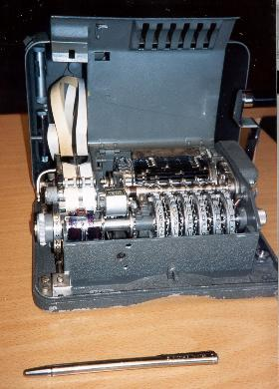
Hagelin Rotor Machine
Notes:
This photo of an Allied Hagelin machine was taken by Lawrie Brown at Eurocrypt'93 in Norway. Note pen for scale, and the rotating cipher wheels near the front.

Slide 114
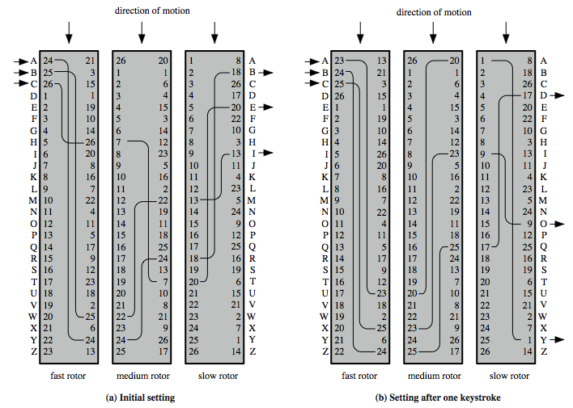
Rotor Machine Principles
Notes:
The basic principle of the rotor machine is illustrated in Figure 2.8. The machine consists of a set of independently rotating cylinders through which electrical pulses can flow. Each cylinder has 26 input pins and 26 output pins, with internal wiring that connects each input pin to a unique output pin. If we associate each input and output pin with a letter of the alphabet, then a single cylinder defines a monoalphabetic substitution. If an operator depresses the key for the letter A, an electric signal is applied to the first pin of the first cylinder and flows through the internal connection to the twenty-fifth output pin. Consider a machine with a single cylinder. After each input key is depressed, the cylinder rotates one position, so that the internal connections are shifted accordingly. Thus, a different monoalphabetic substitution cipher is defined. After 26 letters of plaintext, the cylinder would be back to the initial position. Thus, we have a polyalphabetic substitution algorithm with a period of 26.
A single-cylinder system is trivial and does not present a formidable cryptanalytic task. The power of the rotor machine is in the use of multiple cylinders, in which the output pins of one cylinder are connected to the input pins of the next. Figure 2.8 shows a three-cylinder system. With multiple cylinders, the one closest to the operator input rotates one pin position with each keystroke. The right half of Figure 2.8 shows the system's configuration after a single keystroke. For every complete rotation of the inner cylinder, the middle cylinder rotates one pin position. Finally, for every complete rotation of the middle cylinder, the outer cylinder rotates one pin position. The result is that there are 26 " 26 " 26 = 17,576 different substitution alphabets used before the system repeats.

Slide 115
Steganography
an alternative to encryption
hides existence of message
using only a subset of letters/words in a longer message marked in some way
using invisible ink
hiding in LSB in graphic image or sound file
has drawbacks
high overhead to hide relatively few info bits
advantage is can obscure encryption use
Notes:
Steganography is an alternative to encryption which hides the very existence of a message by some means. There are a large range of techniques for doing this.
Steganography has a number of drawbacks when compared to encryption. It requires a lot of overhead to hide a relatively few bits of information.
Also, once the system is discovered, it becomes virtually worthless, although a message can be first encrypted and then hidden using steganography. The advantage of steganography is that it can be employed by parties who have something to lose should the fact of their secret communication (not necessarily the content) be discovered.

Slide 116
Summary
have considered:
classical cipher techniques and terminology
monoalphabetic substitution ciphers
cryptanalysis using letter frequencies
Playfair cipher
polyalphabetic ciphers
transposition ciphers
product ciphers and rotor machines
stenography
Notes:
Chapter 2 summary.

Slide 117
Cryptanalysis of Caesar Cipher
only have 26 possible ciphers
A maps to A,B,..Z
could simply try each in turn
a brute force search
given ciphertext, just try all shifts of letters
do need to recognize when have plaintext
eg. break ciphertext "GCUA VQ DTGCM"
Notes:
With a caesar cipher, there are only 26 possible keys, of which only 25 are of any use, since mapping A to A etc doesn't really obscure the message! Note this basic rule of cryptanalysis "check to ensure the cipher operator hasn't goofed and sent a plaintext message by mistake"!
Can try each of the keys (shifts) in turn, until can recognise the original message. See Stallings Fig 2.3 for example of search.
Note: as mentioned before, do need to be able to recognise when have an original message (ie is it English or whatever). Usually easy for humans, hard for computers. Though if using say compressed data could be much harder.
Example "GCUA VQ DTGCM" when broken gives "easy to break", with a shift of 2 (key C).

